Slide 1

DSLab 2020
The Data Science Lab Week 3
Data Science Lab – Spring 2020

Slide 2
Outline
Industry presentation
Big data journey
Bootstrapping your digitalization journey
Technology overview
Hadoop HDFS, MapReduce, and Hive
Exercises week 3

Slide 3
Bootstrapping your Digitalization Journey

Slide 4
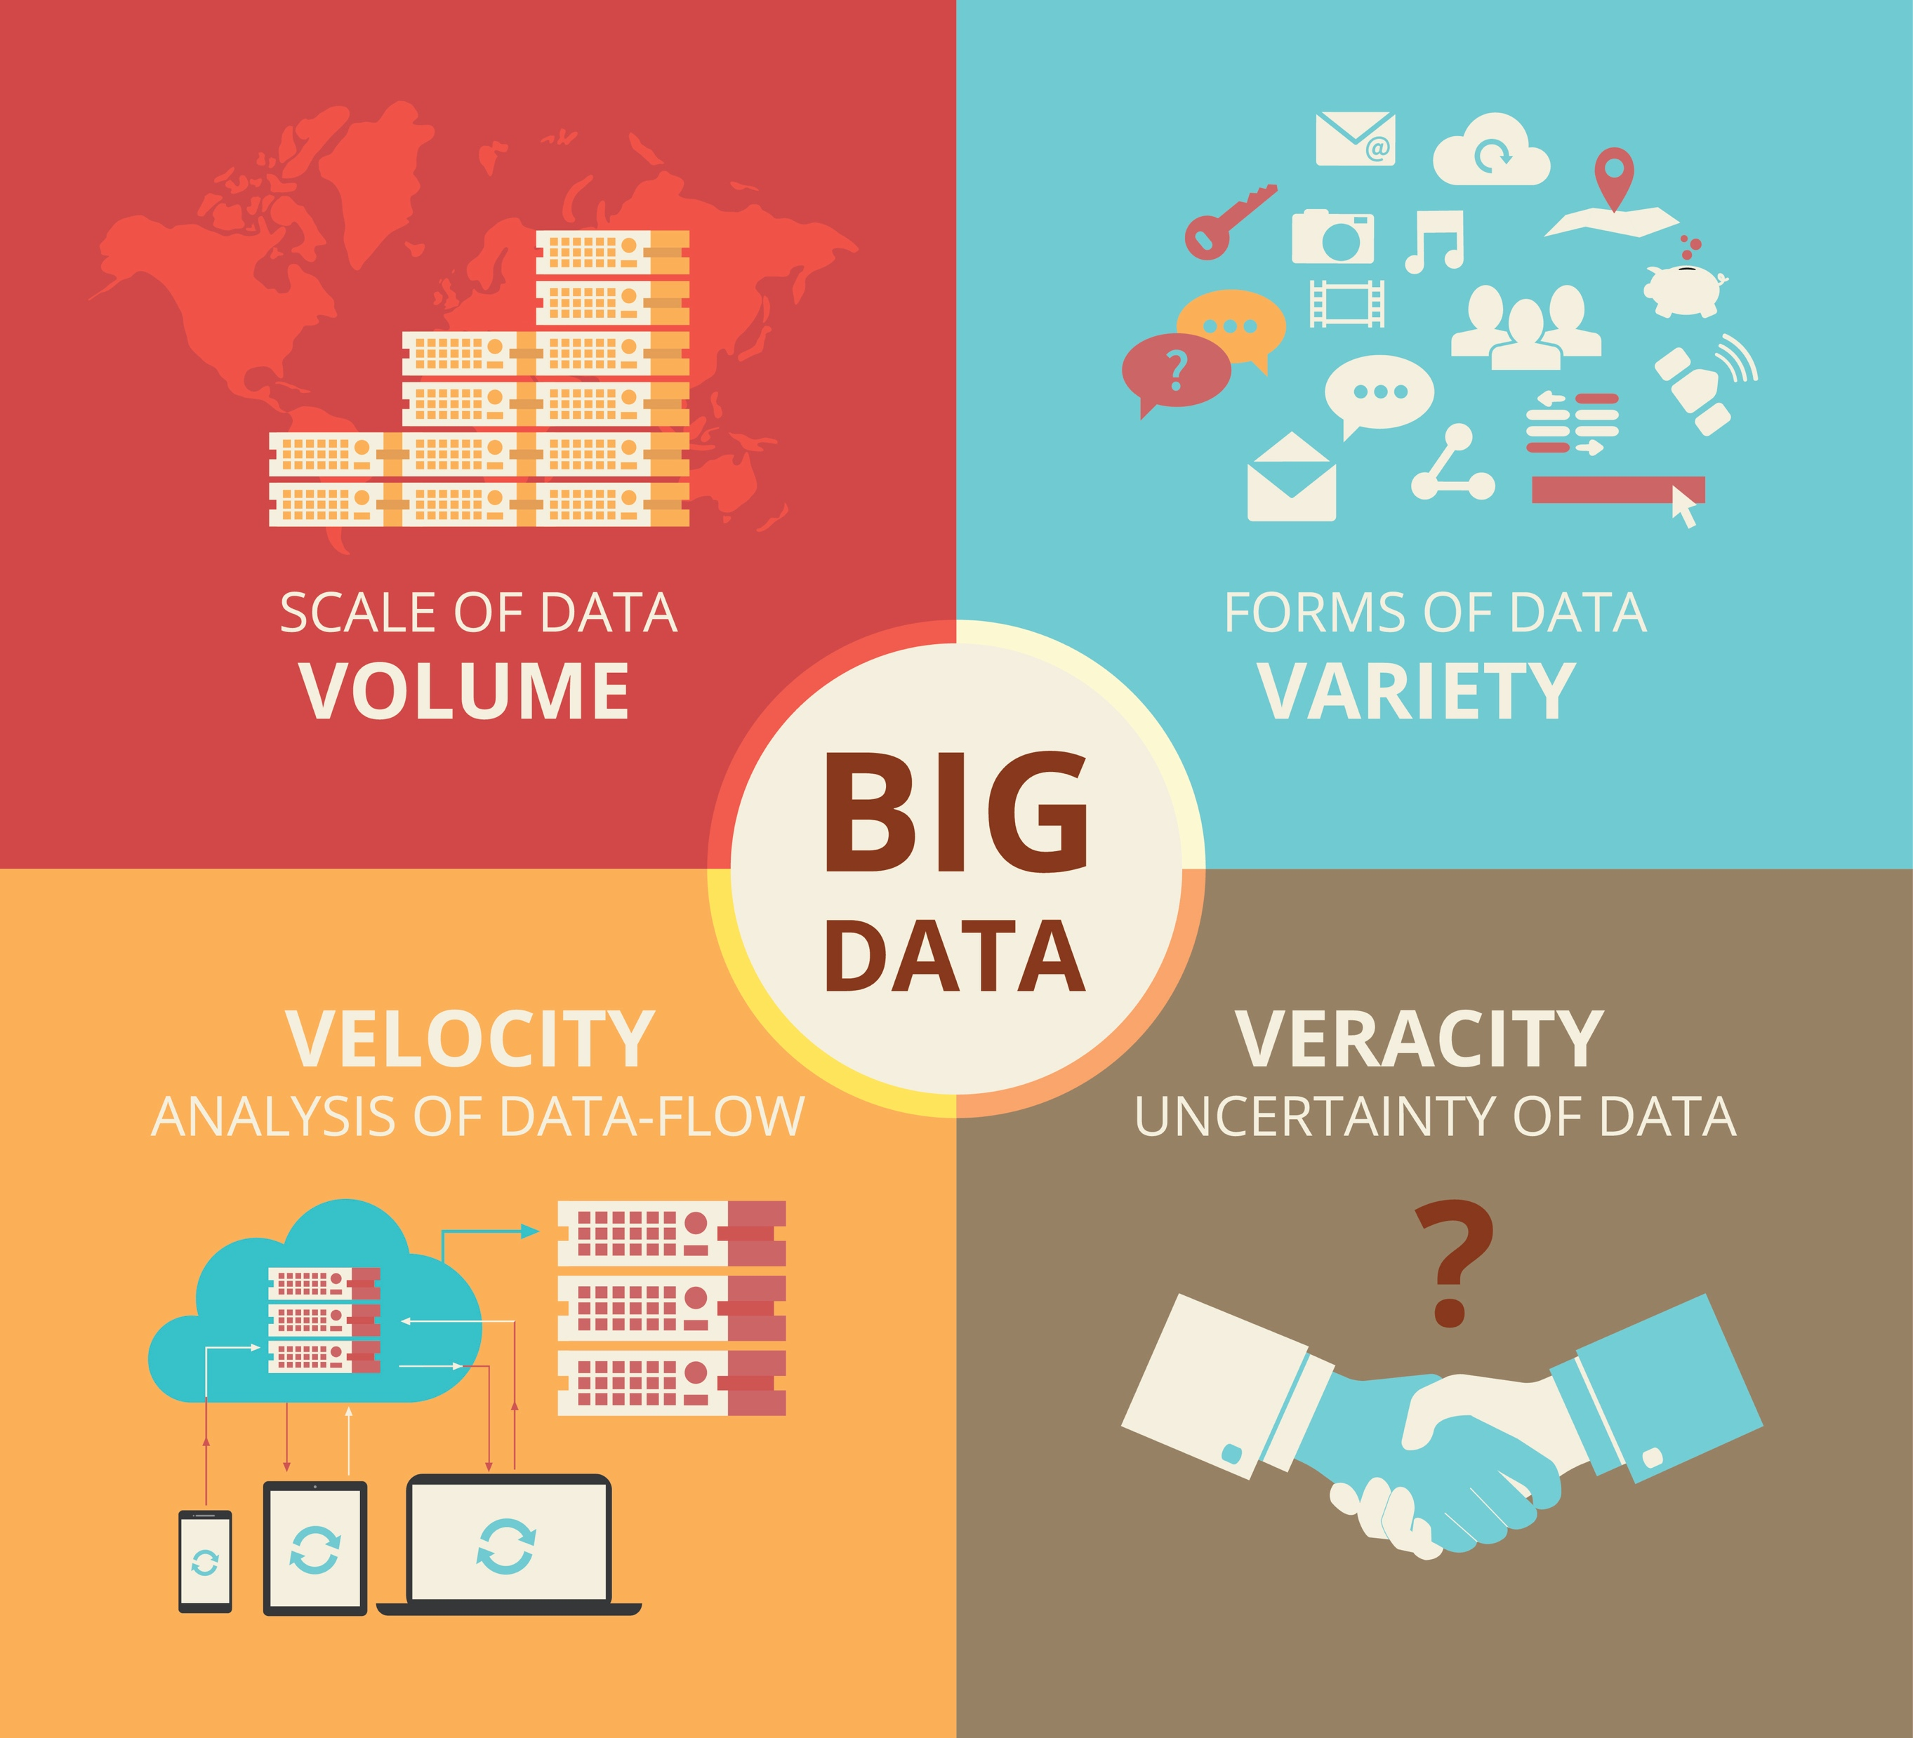
Big Data’s 4 Vs
Notes:
So you have identified a bunch of very different data sources, in silos… high volume, and more importantly, high variety.

Slide 5
How shall I start the journey?
Wrong!
Easy! I’ll go ahead and start building ML models, right?
Instead, start by…
Ingesting data
Cleaning data
Integrating data
In most companies, this actually represents 75% of the work
Only then can you make the last 25% (analytics) successful
Build a data lake to tame your data first!
© P. Cudre-Mauroux https:\\exascale.info
Notes:
How shall I bootstrap my digitalization efforts?
Cleaning and integration done with domain experts
How about extracting/ visualizing KPI’s, gaining buy-in’s from LOB professionals?

Slide 6
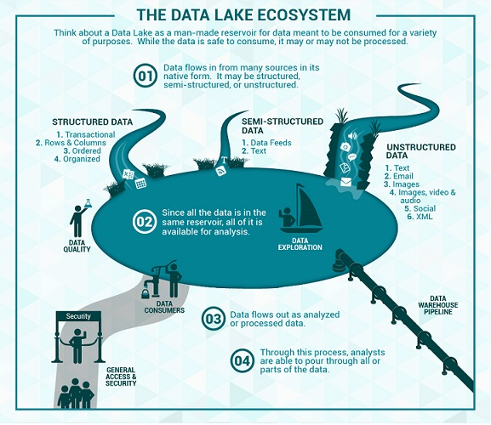
What is a Data Lake?
Conceptually: solution to co-locate and share data in its native form
© DunnSolutions
© Zaloni
Notes:
raw data: in its natural format
Data lake is one place to put all the data enterprises may want to use, including structured and unstructured data
Storage repository that holds a vast amount of raw data in its native format until it is needed
Store it all in one place, figure out what to do with it later
Requiring little or no processing for adapting the structure to an enterprise schema

Slide 7
Typical Big Data Architecture (2018)
Data
Processing
Source
Model
Deployment
&
Custom
Applications
Interaction
&
Visualization
Ingestion
Layer
Data
Lake
Source
Source
Models
© P. Cudre-Mauroux https:\\exascale.info

Slide 8
Technology Overview
Spring 2020 - week #3

Slide 9
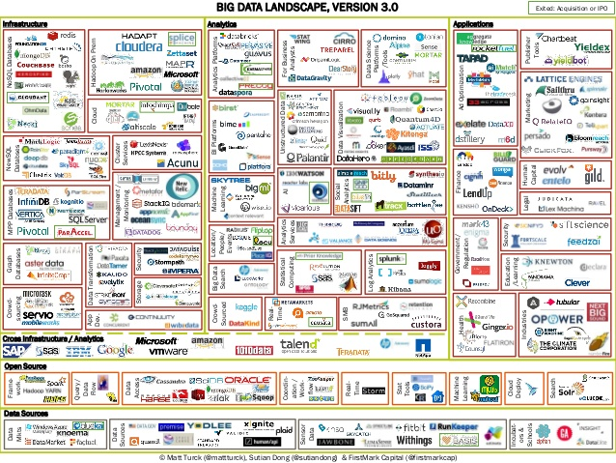
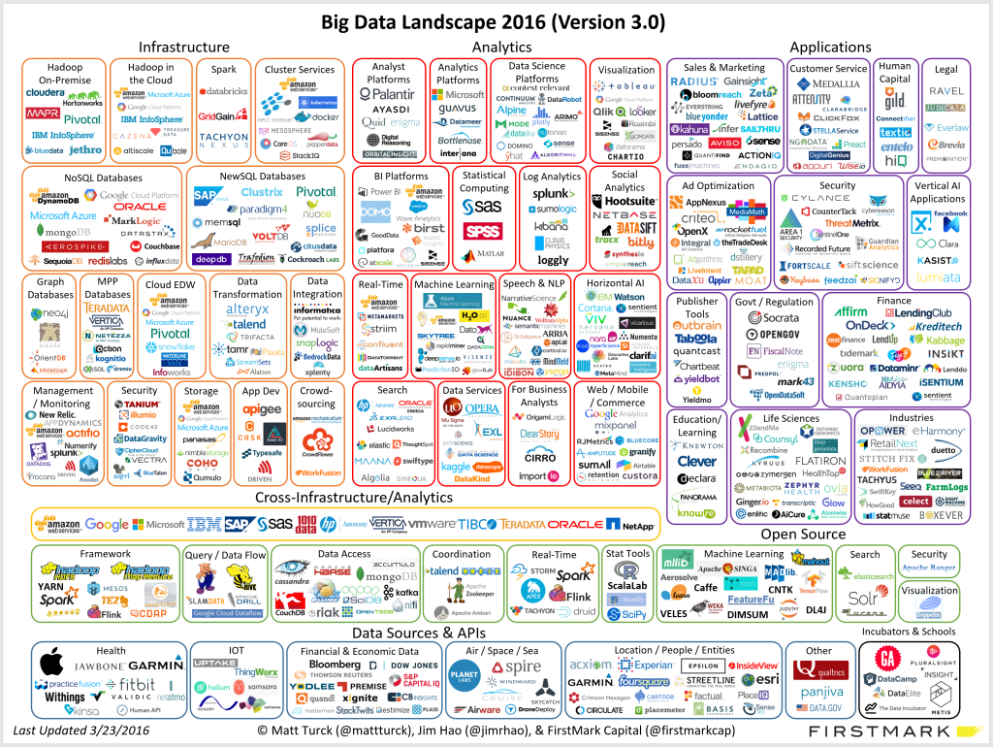
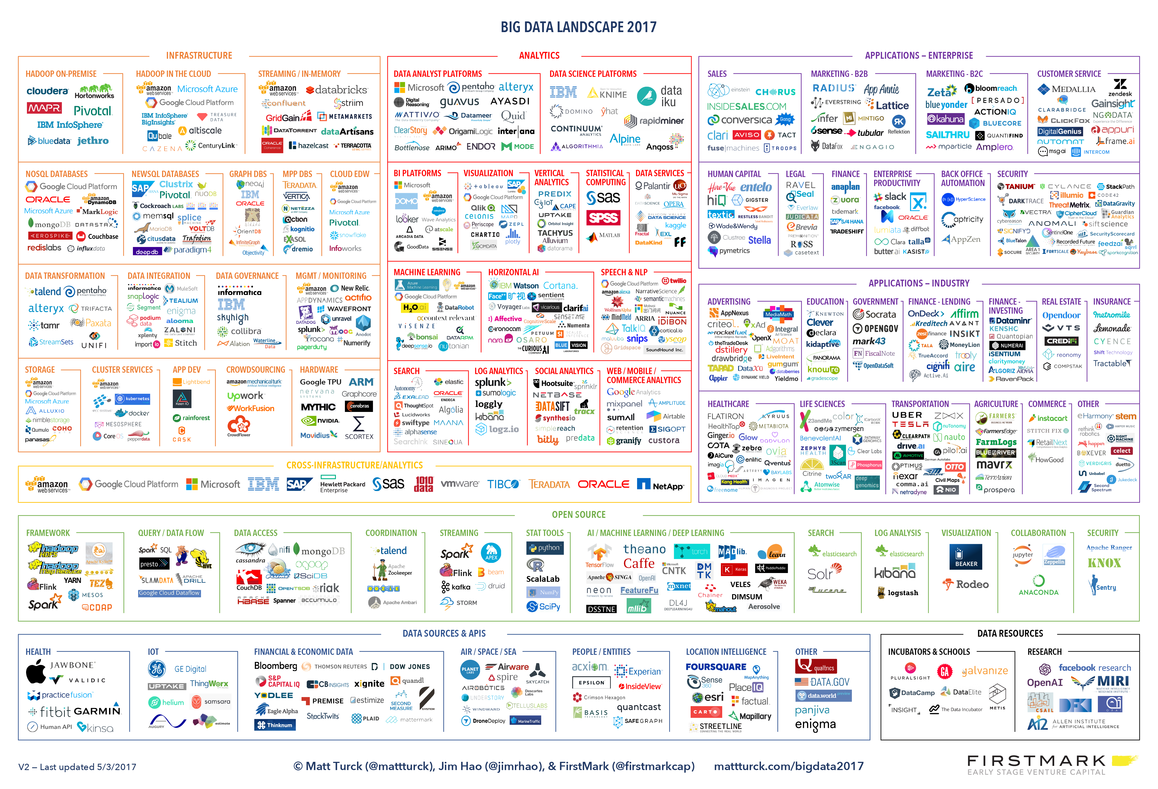
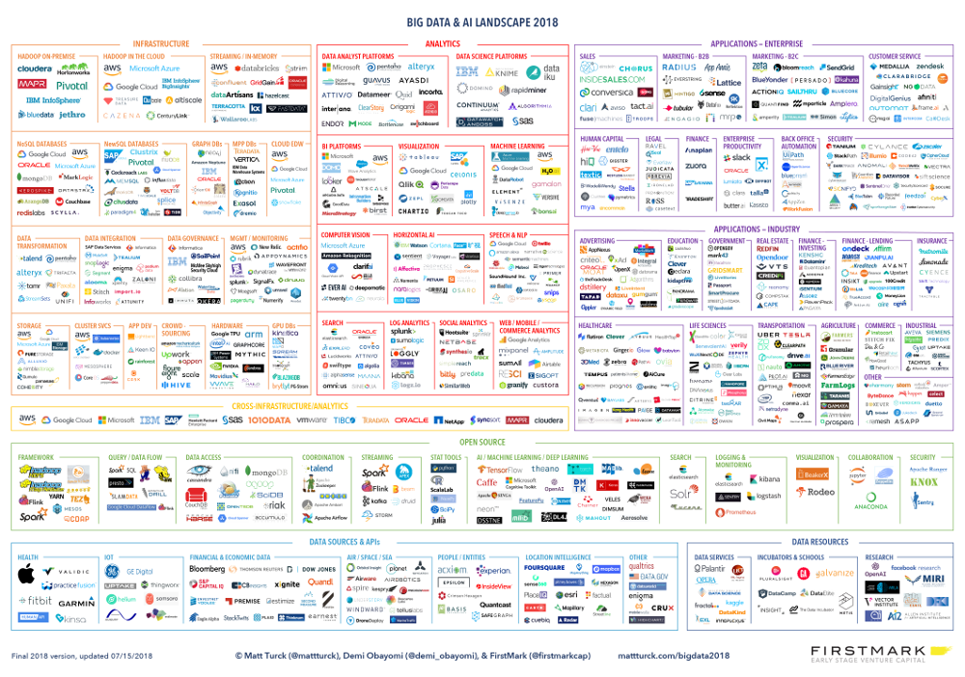
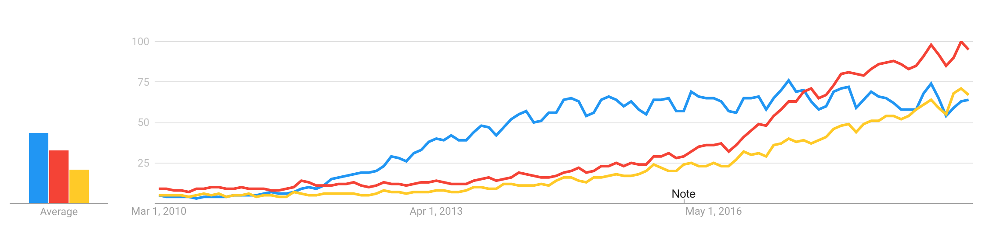
Big Data Landscape Evolution – A Moving Target
2014
2016
2017
2018
Google Trends
Big Data
Machine Learning
Data Science
(Sources: Matt Turck - http://mattturck.com ; trends.google.ch)

Slide 10
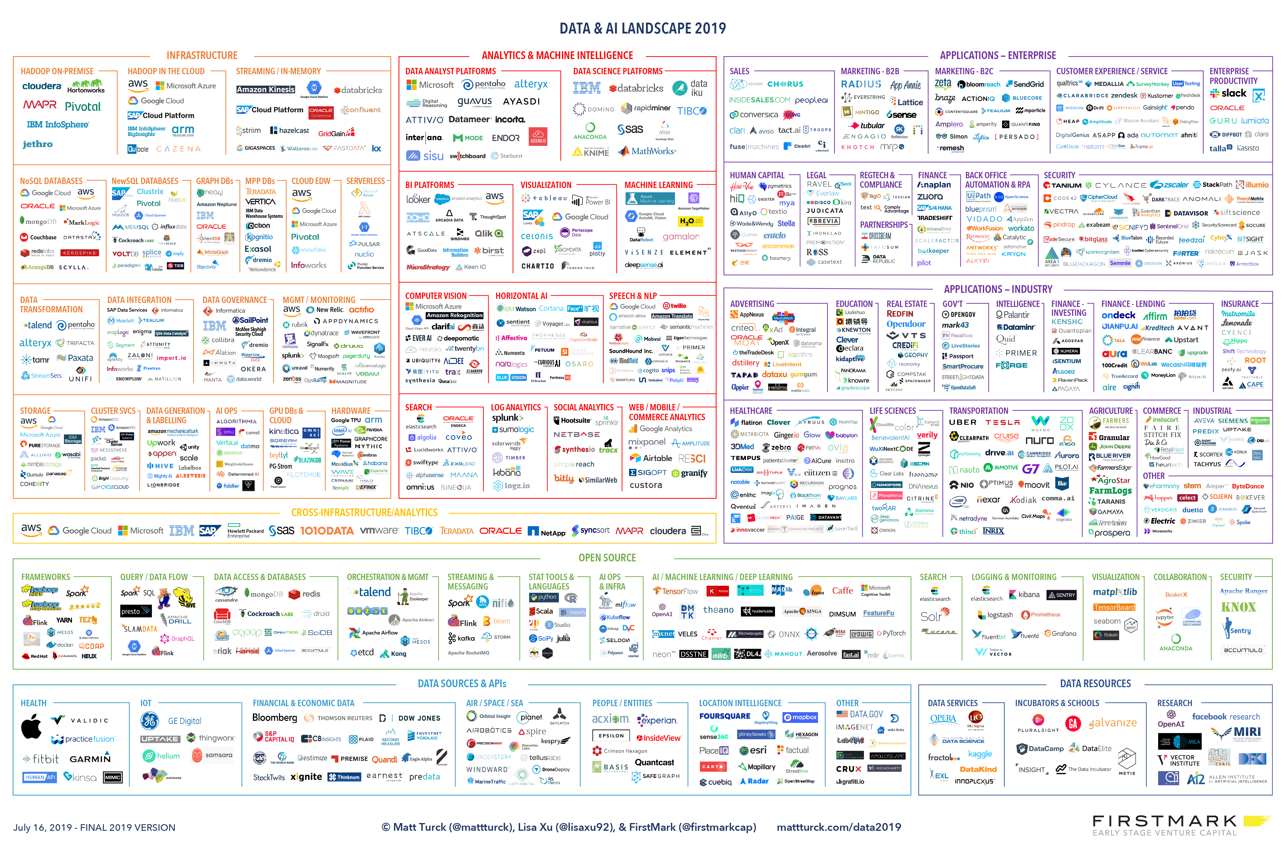
Big Data Landscape Evolution – 2019
(Sources: Matt Turck - http://mattturck.com ; trends.google.ch)

Slide 11
Today’s Objectives
Get acquainted with the Big Data ecosystems
Find your way in the Big Data jungle, explore it more efficiently

Slide 12


Addressing the Big Data Challenges
cost
scale up
Bigger machines: scale up (a.k.a vertical scaling)
… the High Performance Computing way (HPC)
RAM
capability
Break the
CPU/RAM/Disk bounds
DISK
CPU
Notes:
Scale UP (vertically), Scale Out (horizontally)
Scale out => many machines => distributed computation and distributed storage => framework to manage the distributed systems.

Slide 13
Addressing the Big Data Challenges
cost
scale up
scale out
RAM
capability
Break the
CPU/RAM/Disk bounds
DISK
(…)
CPU
More machines: scale out (a.k.a horizontal scaling)
… the commodity hardware (cloud) way
Notes:
Scale UP (vertically), Scale Out (horizontally)
Scale out => many machines => distributed computation and distributed storage => framework to manage the distributed systems.

Slide 14
Addressing the Big Data Challenge
Horizontal scaling (scaling out) entails distributed computing across a large number of compute servers
Challenges of distributed computing are:
The same code should transparently work on 1, 10, or 10,000 servers
Assume problem can be broken down into chunks and each chunk calculated locally
The data must be accessible from anywhere
High availability: the systems must survive one or more server failures with no impact on operations
Resource utilization must be optimized
Minimize hot-spots with a good load-balancing strategy
Bring compute to data
The systems should support elastic scaling
Add/remove machines without requiring maintenance down-times

Slide 15
The Clash: should I Stream, or should I Batch?
You want an updated answer as more information becomes available? streams
AKA: Data in motion, or Fast data
Continuous computation that never stop, process infinite amount of data on the fly
Designed to keep size of in-memory state bounded, regardless of how much data is processed
Update the answer as more data becomes available
Operate on small time windows
E.g.:
Spark Streaming, Flink, Storm, Kafka Streams,
Can wait until all information is available for a more accurate answer? batch
AKA: Data at rest
Operates on finite size data sets, and terminate when all data has been processed
Hadoop MR, Spark

Slide 16
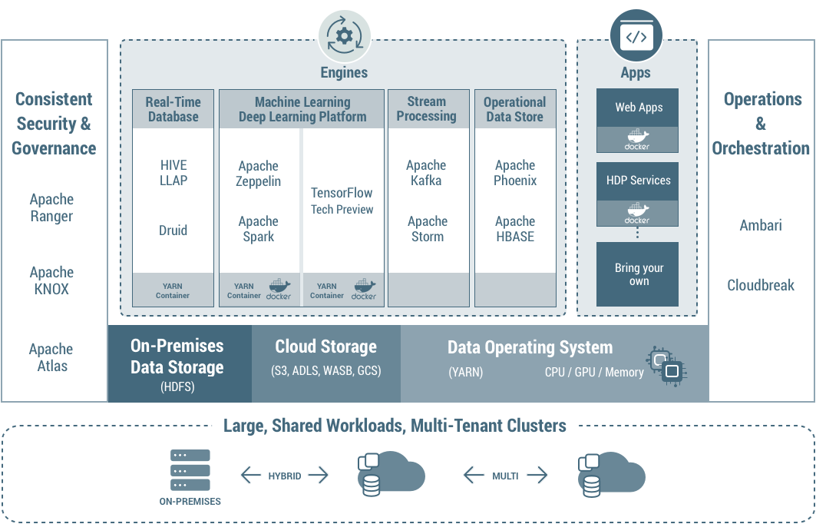
Addressing the Big Data Challenge - Technologies
week 3
week 5-8
week 9
https://www.cloudera.com/products/hdp.html

Slide 17
Hadoop HDFS, Map Reduce, and Hive
Spring 2020 - week #3

Slide 18
Hadoop Distributed File Systems (HDFS) Essentials
What you need to know
NameNode: (master node) manage namespace, must have at least one, preferably two for high availability
DataNode: (worker node) serve the data, one per server
Data blocks are in units of 64MB (default)
Not for small files, use HDFS for large files only
Write-once, you cannot modify a file in place (it must be replaced)
Redundancy, all blocks replicated x3 (default)
Redundancy against failures
Statistically easier to move computation next to the data and load-balance the CPU usage
HDFS command line, with POSIX like interface (Hadoop2):
hdfs dfs [–help]
Notes:
[1] http://comphadoop.weebly.com/

Slide 19
Popular Big Data Formats
Big data components (Hive, Spark, etc) give you several formatting options for storing and exchanging data, the most popular are
Plain text (csv, json, …)
Parquet:
column-oriented
integrated compression
ORC:
column-oriented in collections of rows, splittable by row collections
integrated compression
indexed
Avro:
row-oriented, splittable and support block compression
Notes:
ORC more control on how files are splitted, some indexing for faster access.
-

Slide 20
HDFS – under the hood
Notebook container
1: wget –o myfile “https://...”
NameNode
contains meta data about hdfs directory tree structure, location of referenced contents etc. Not the content itself.
2: hdfs dfs –put ./myfile /user/gaspar/
https user agent
DataNode
DataNode
DataNode
DataNode
This is where the data is stored. DataNodes do the heavy processing. Data is partitioned in blocks and each block replicated (default 3x) for redundancy and load balancing purpose.
Renku notebook
EPFL – IC cluster
Horthonworks Data Platform (HDP)
EPFL – IC cluster
Notes:
There was some confusions about what is really happening to the hdfs data.
This slides illustrates the movement of the data during the first part of exercice week#5
1. Students ssh on the iccluster042 in a terminal. This is their access point to the IC cluster where the big data platform is running, and from where they can run command line “clients” that interact with other components of the big data platform, such as the hdfs command line.
2. The loop counter data was downloaded to icculster042 with the wget command. At this point the file is locally on iccluster042 (if copied to /tmp), or on a network-accessible disk, which is mounted on iccluster042 and appear as a normal drive (if copied to their home directory). In either case it is a normal file (non-distributed) systems.
Things become more interesting when they copy the the data to hdfs with the hdfs command line. The hdfs command is a client. This command interacts with HDFS services distributed on other nodes in the iccluster. There are two kinds of nodes: many datanodes, used to store the actual data. Data nodes are responsible for the heavy lifting. This is the node that does most of the work when you run an hdfs dfs –put command. It is also responsible for packing the data for optimizing space etc. The namenode(s) used to maintain the information about where data is stored, how it is stored etc. This is the node that does most of the work when you run an hdfs dfs –ls command: you are not looking at the content, you only need to know where to find it.
The namenodes make it appear as if the data is stored on a single location that is network accessible to iccluster042. In reality this data is partitioned into blocks, and 3 copies of each block are distributed across datanodes’ local disks.

Slide 21

HDFS – under the hood
(eg. hdfs dfs –get)
(eg. hdfs dfs –put)
source: https://hadoop.apache.org/docs/current/hadoop-project-dist/hadoop-hdfs/HdfsDesign.html
Notes:
For more info, students are encouraged to read the documentation on https://hadoop.apache.org/docs/current/hadoop-project-dist/hadoop-hdfs/HdfsDesign.html

Slide 22
MapReduce in a Nutshell
Intermediate results on HDFS file systems or in-memory
(key-value pairs)
1
1
1
1
4
1
1
1
1
4
1
1
3
3
1
1
2
1
1
Output
1
1
2
Input data
Split
1
1
Reduce
Map
Shuffle
(key,value) pairs
Notes: In HDFS the data is already ”split” into blocks and ”Mapping” can be done on all worker nodes where data blocks are located. However, beware of compressed data! not all compression algorithm are “splittable” in blocks, and MapReduce will not chunk it (splittable: bzip2, LZA, not splittable: gzip, snappy).

Slide 23
MapReduce in a Nutshell
Intermediate results on HDFS file systems or in-memory
(key-value pairs)
(key-value pairs)
1
1
1
1
1
2
4
1
1
1
1
4
1
2
1
3
3
1
1
2
2
1
Output
1
1
1
2
2
Input data
Split
1
1
Reduce
Map
Combine
Shuffle
(key,value) pairs
Notes: In HDFS the data is already ”split” into blocks and ”Mapping” can be done on all worker nodes where data blocks are located. However, beware of compressed data! not all compression algorithm are “splittable” in blocks, and MapReduce will not chunk it (splittable: bzip2, LZA, not splittable: gzip, snappy).
Notes:
Add combiners in order to minimize the volume of shuffle.

Slide 24
MapReduce gotchas
Shuffling is the network bottleneck of MapReduce operations, because placement of “reducers” cannot be optimized based on data locality.

Slide 25
MapReduce Best Practices
Optimization starts with good data partitioning practices to better balance the load (on CPU, RAM), and minimize data shuffling (network bottlenecks)

Slide 26
HIVE
What you need to know
Data warehouse software facilitates reading, writing, and managing large datasets
Built on top of Hadoop,
Easy access to data stored in HDFS or in other data storage systems (HBase, ...) via SQL
Distributed SQL Query engine execution via Tez, Spark, or plain MapReduce.
source: https://cwiki.apache.org/confluence/display/Hive/Design

Slide 27
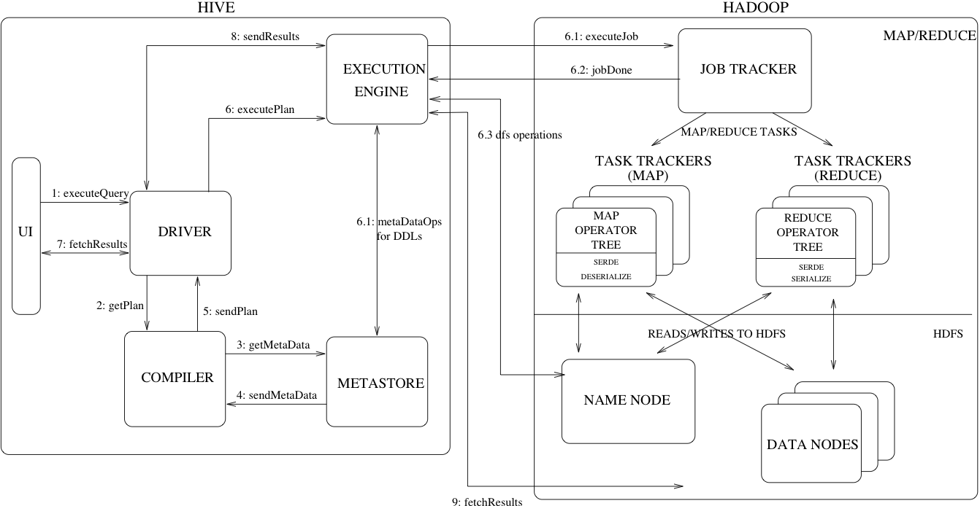
HIVE – under the hood
source: https://cwiki.apache.org/confluence/display/Hive/Design
Notes:
Hive is provides an SQL-like interface. It is actually an MapReduce engine with and HDFS storage backend.
It consists of several components:
A metastore, which contains information about the tables, their schemas, where they are located etc. If you specified location ‘/homes/yourname/hive’ when you created a database this is the directory where the metastore is located on hdfs.
- A Driver, this is the components that receives the SQL queries and is responsible of the orchestration between the other components to execute the query and return the results, in the order specified in the graph above.
A compiler, this component transforms the SQL queries into an optimized DAG of stages, using information it gets from the metastore. A stage is either a map reduce job, a Hive metadata operation, or an HDFS operation.
An execution engine, is the component responsible for executing the map reduce jobs created by the compiler. Most recents version of Hive uses Tez, which dynamically reconfigure the plan at run time to optimize the uses of available resource.
The backend is a Hadoop mapreduce engine. The important point is that data (tables content) is stored in HDFS and SQL queries on the data are transformed into map reduce jobs. It allows you to take any existing CSV, JSON, parquet (or other format), decorate this file with one or more schema meta data with the hive “create external table” (i.e. apply a database schema on it, the info is stored in the metastore), and execute SQL queries which are translated into map reduce jobs on the CSV, JSON, parquet data. In this case dropping an “external” Hive table will remove the metastore data but not the original data itself.
Students are encouraged to read https://cwiki.apache.org/confluence/display/Hive/Design for more info.

Slide 28

The Clash: should I Stream, or should I Batch? (Illustrated)
12,13,15,19,22,23,25
stream with look-ahead window of N=2 (wait for more events before sorting last N)
12
15
13
19
23
22
25
28
30
time received
Example: process events by timestamps, events can arrive out of order.

Slide 29
The Clash: should I Stream, or should I Batch? (Illustrated)
12,13,15,19,22,23,25,27,28,29 (oops, just got a 26)
stream with look-ahead window of 2
12
15
13
19
23
22
25
28
30
27
29
26
time received
(end of batch)
Example: sort events by timestamps, events can arrive out of order.
Streams: small windows (response is behind N=2 events in example), hence faster answers but can be inaccurate because can’t predict events after look-ahead window, e.g. 26 is out of order in example. Response must be amended or event thrown out. We can increase N, which delays the response.

Slide 30
The Clash: should I Stream, or should I Batch? (Illustrated)
12,13,15,19,22,23,25
12,13,15,19,22,23,25,28,29,33,35,38,40
stream
batch
12
15
13
19
23
22
25
28
30
27
29
26
35
38
40
time received
(end of batch)
Example: process events by timestamps, events can arrive out of order.
Streams: faster answers but can be inaccurate (e.g. next events are out of order)
Batch: accurate, all information is available, but response is slower (must wait for all the events)

Slide 31
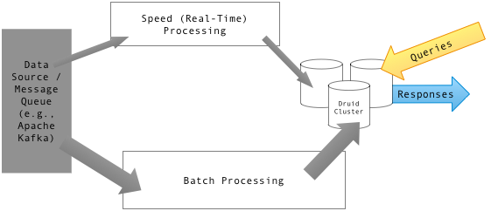
The Clash: should I Stream, or should I Batch? λ architecture

Slide 32

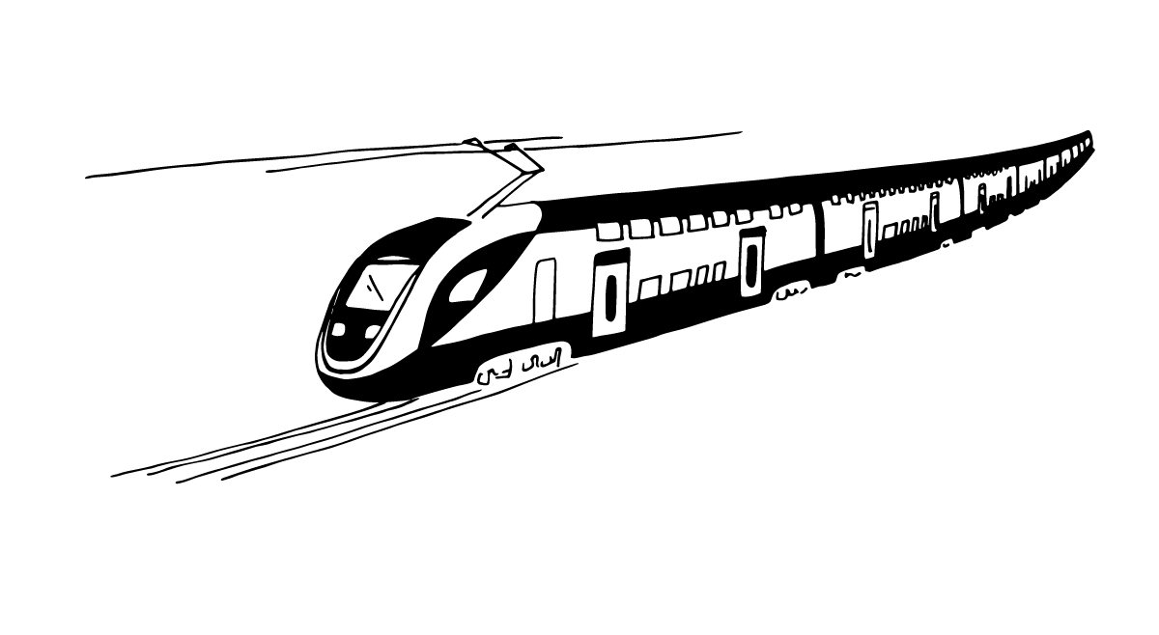
Big Data Illustrated – A Popular Real World Pattern
Real-time
GPS Data
Data Stream
(Kafka)
Prediction
(Storm or Spark streaming)
ETA
Streams (continuous processing)
Model
Historical Data DBMS
(Hive)
Model Training
(Spark)
Import (Scoop)
Archives
Batch (e.g. learn a new model once a month)

Slide 33
Hadoop MapReduce Distributions
On-Premise (self-hosted) Big Data Distributions
Cloudera (Hortonworks) Data Platform (used in this lab)
MapR Hadoop Distribution
IBM Open Platform with Apache Hadoop
DC/OS, Mesosphere
…
Cloud-based (all-purposes) Big Data Platforms as a Service
EPFL IC Cluster (used in this lab)
Amazon EMR
Microsoft Azure HDInsight
Alibaba Cloud E-MapReduce
...
Notes:
They are like linux distributions, apache big data open sources with vendor-specific distinctive features added to it

Slide 34
Exercises Week 3
Spring 2020 - week #3

Slide 35
Start your engines
Head over to the RENKU webpage
https://renku.iccluster.epfl.ch
You will need the EPFL VPN if connecting from outside the EPFL network
Find and fork project dslab2020/dslab-exercises-week-3
Follow the instructions from the README
Exercises week 2 are available at
https://renku.iccluster.epfl.ch/projects/dslab2020/dslab-solutions-week-2/
Notes:
conda --version
conda update conda
conda info --envs or conda env list
conda create --name DSLab2019 python=3.7
conda activate DSLab2019
conda info --envs
python --version
conda search jupyter
conda install jupyter
conda list
conda search scikit-learn
# conda install scikit-learn=0.20.2=py37hebd9d1a_0
# conda list
conda deactivate
conda env remove -n DSLab2019

Slide 36
Thank you!

